Slide 1
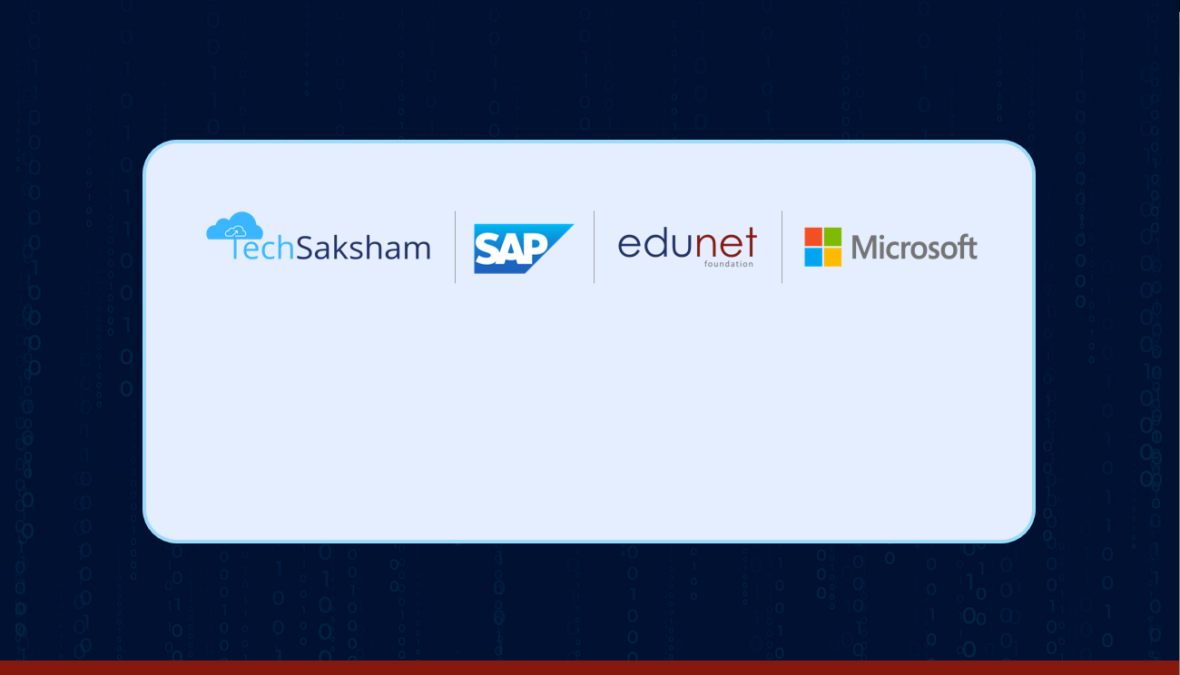
OBJECT DETECTION
Team Members:
G. Srinadh – 20B21A4225
G. Ram Sundar – 20B21A4219
M. Karthik – 20B21A4269
Hanuman Kasi – 20B21A4240

Slide 2
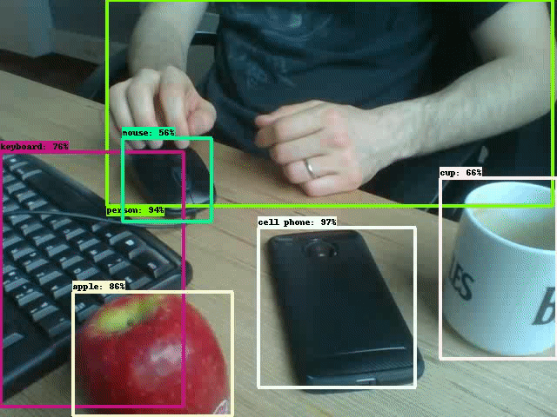
OBJECT
DETECTION

Slide 3
Abstract:
Our project focuses on developing a robust and efficient object detection system using state-of-the-art deep learning techniques. We aim to address real-world challenges in various domains, such as autonomous driving and surveillance. By leveraging advanced neural network architectures and optimizing inference speed, our solution offers accurate and rapid object detection, promising significant advancements in safety and automation.

Slide 4

Object detection is a computer vision task that involves identifying and locating objects of interest within an image or a video stream.
With this kind of identification and localization, object detection can be used to count objects in a scene and determine and track their precise locations, all while accurately labeling them.
What is object Detection?

Slide 5

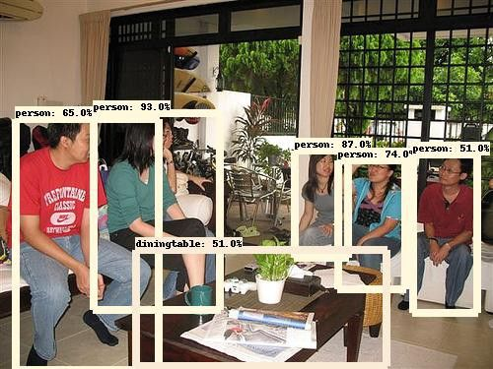
The architecture of the object detection application involves a combination of components, including Flask, OpenCV, and model files.
FLASK:
Flask is a web framework for Python that serves as the backbone of the application. It provides the infrastructure for building web applications, handling HTTP requests, and serving web pages.
Open-CV:
OpenCV is a powerful open-source computer vision library that provides a wide range of tools and functions for image and video processing, including object detection.
Model files:
Model files are pre-trained deep learning models used for Object Detection.
‘frozen_interface_graph.pb’: This file contains the pre-trained model’s architecture and learned parameters
‘ssd_mobilenet_v3_large_cocc_2020_01_14.pbtxt’: This file contains the model’s configuration and metadata.
ARCHITECTURE

Slide 6

1.Image Decoding.
The application starts by decoding the uploaded image. This involves reading and decoding the image data to convert it into a format that can be pre-processed by OpenCV libraries
2.Aspect Ratio Preservation.
The application adjusts the image size while preserving its original aspect ratio to prevent distortion of objects within the image.
3.Resizing.
The application resizes the image to meet the model's input size requirements, with a new width of 320 pixels while preserving the aspect ratio.
4.Input size adjustments.
The model's input size is adapted to match the resized image dimensions using the `model.setInputSize()` function in the code.
5.Normalization.
The application normalizes the image by adjusting pixel values using functions like `model.setInputScale()`, `model.setInputMean()`, and `model.setInputSwapRB()` to ensure they fall within the desired range for the model's input.
6.Other preprocessing steps.
Additional preprocessing steps, such as color space conversions, data type conversions, and channel reordering, may be needed based on the model's specific requirements.
Pre
Processing
of an
Image

Slide 7
Algorithm:
In my flask application, I have implemented object detection using the Single Shot Multibox Detector(SSD) algorithm. The specific model used is based on the MobileNetV3 architecture, indicated by the files.
‘ssd_mobilenet_v3_large_coco_2020_01_14.pbtxt’ and ‘frozen_inference_graph.pb.’
This algorithm is known for its real-time-object detection capabilities and is widely used in computer vision tasks.

Slide 8

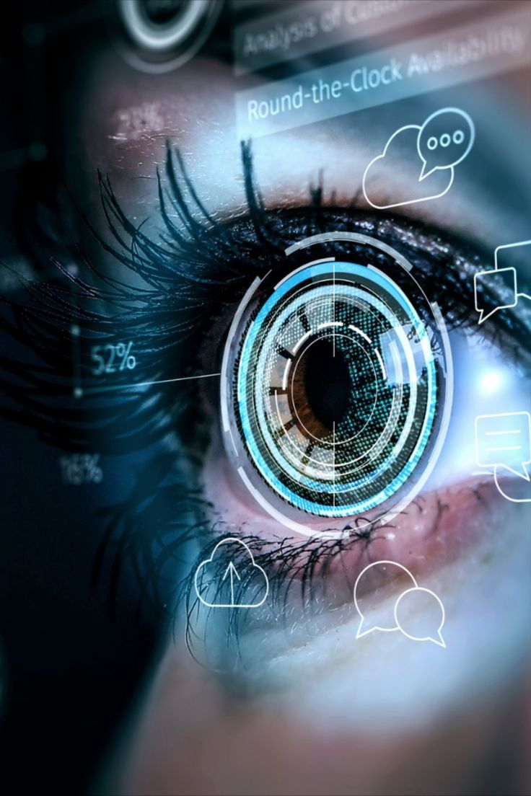
Scope of object detection
Autonomous vehicles
Security and surveillance
Retail and inventory Management
Medical Imaging
Industrial Automation
Agriculture
Environmental Monitoring
Augmented Reality(AR) and Virtual Reality(VR)
Smart Cities
Search and Rescue
Sports Analytics
Content Moderation
Robotic Applications
Entertainment and Gaming
Forensic Science

Slide 9

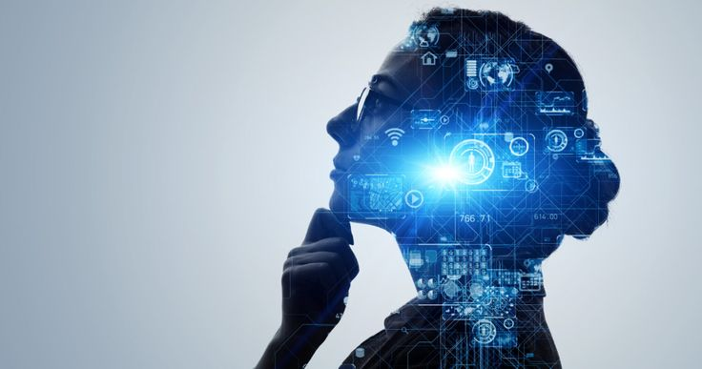
Future Enhancements
Enabling live video analysis with reduced processing time
Making the code to track multiple objects
Creating a user-friendly interface
Cloud-based object detection for scalability and accessibility
We develop filters to enhance accuracy
We include human pose estimation for fitness and health care apps
We Enable users to train models that are not pretrained
We ensure to make access to various platforms and applications

Slide 10
VIDEO OF THE PROJECT
https://drive.google.com/file/d/1AQ6eOeyFdqP5M_fZd2bvRvWwrNZ5OXTF/view?usp=sharing

Slide 11


